Slide 1

Dirty tactics against LibreOffice in public administration, and how to overcome them
Otto Kekäläinen
Free Software Foundation Europe – FSFE.org

Slide 2
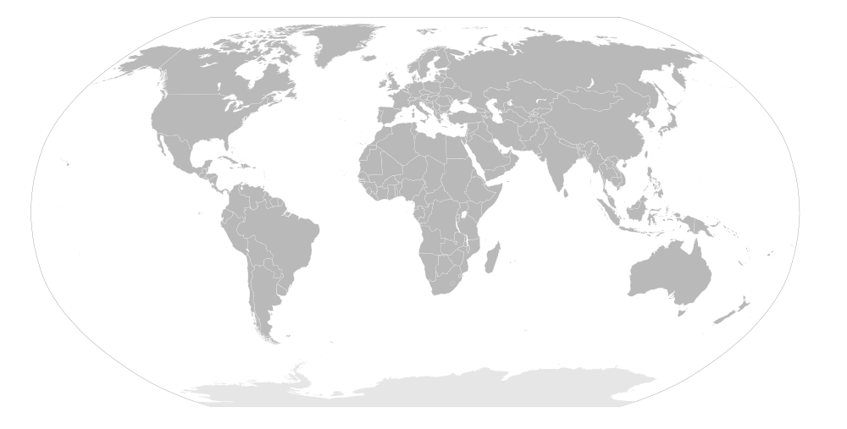



Free Software Foundation Europe e.V
Notes:
FSFE is an independent organization and you might heard of its sister organizations like the US-based Free Software Foundation. FSFE has offices in Berlin and Dusseldorf and country teams all around Europe. As said I volunteer as the Finnish country team coordinator. FSFE's accomplishments include among others working as a third party in the EU vs. Microsoft monopoly court case, which lead to record fines for Microsoft and forced Microsoft to implement the browser ballot screen in all Windows desktop computers sold in the EU.
Today I am going to talk about promoting Free Software in general and promoting LibreOffice in particular, and I'm going relate it all to the experiences we've had in Finland.
Here is some headlines from Finland.

Slide 3
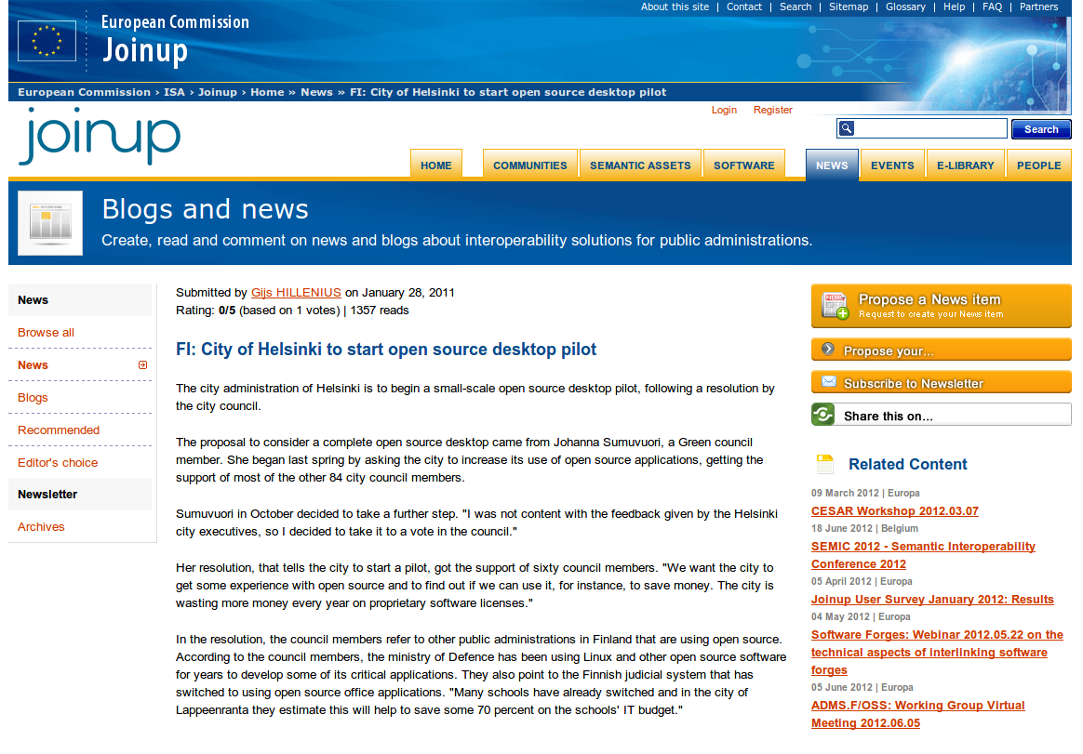

Slide 4
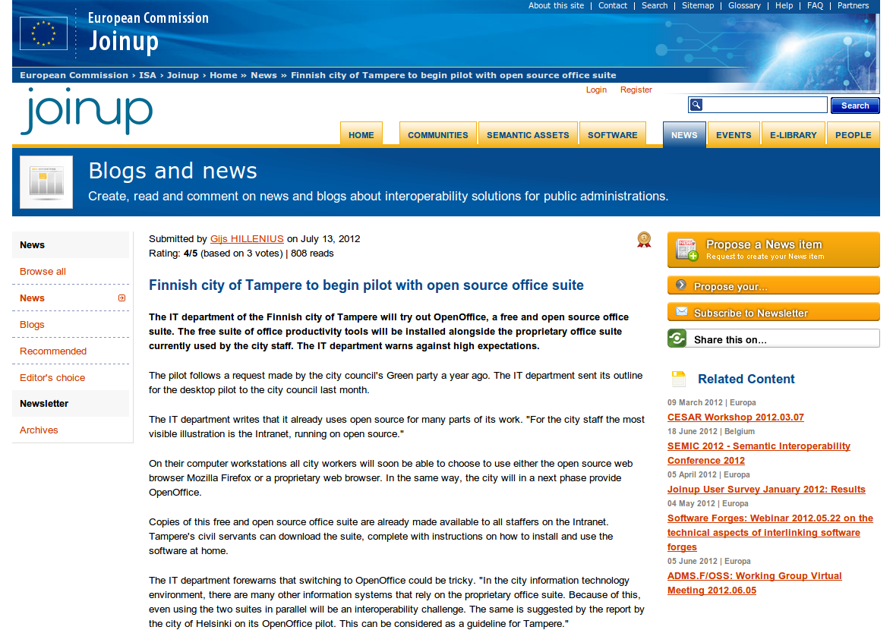

Slide 5
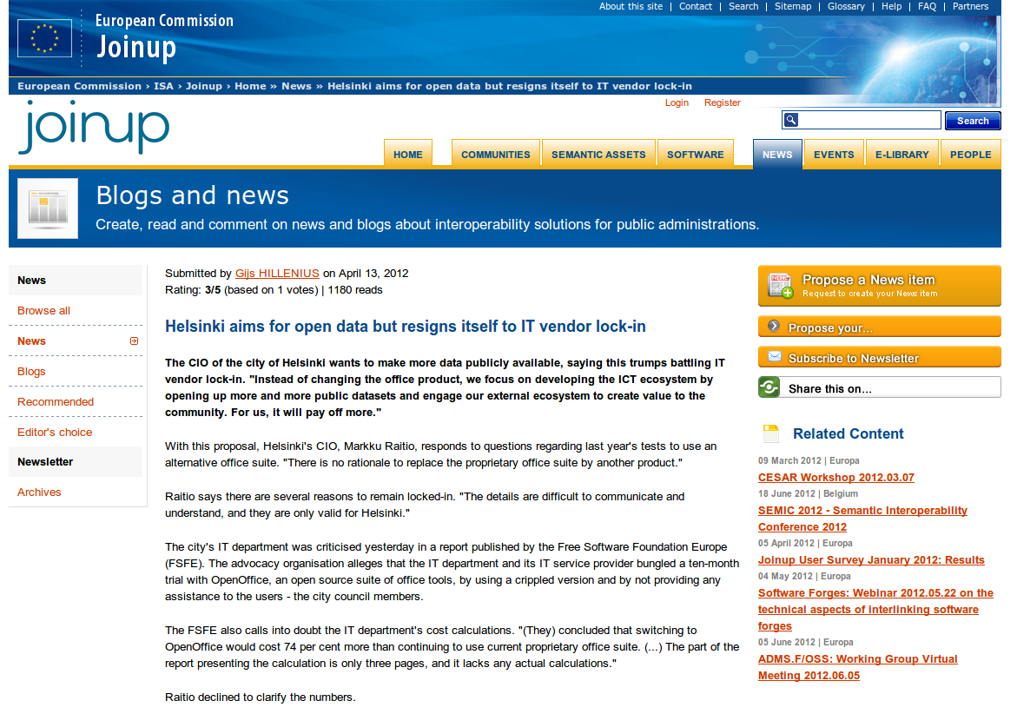

Slide 6
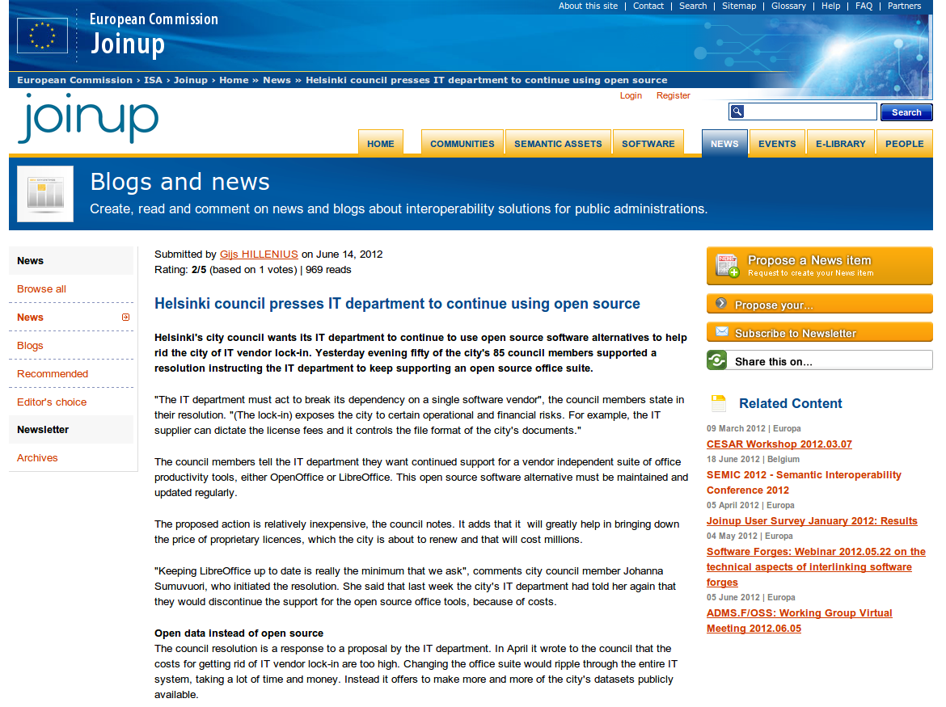

Slide 7
News items at joinup.ec.europa.eu and fsfe.org/fi/
Notes:
Helsinki, Tampere and Turku are some of the biggest cities in Finland, and they all had majority backed city council initiatives to increase the use of LibreOffice and other open source software during the last two years.
Now let's do a little poll.
How many of you would like to see LibreOffice get more popular? Raise you hand.
Now how many of you actually believe that LibreOffice has the potential to one day become the most popular office suite in the world?

Slide 8
It is possible
Notes:
I certainly believe it is possible. We have seen fast technological shifts before. It just needs to have a little bit more of push and some obstacles removed, as I will discuss in my presentation today.
Now raise your hands: Who thinks your own country and government would benefit in particular of LibreOffice?
Yes, I assume most of you don't like the idea of paying taxes to governments so that they then spend them on closed source software and ship truckloads of money to the USA, Ireland or some tax haven. Also I assume the idea of denying local business opportunities and limiting the governments own freedoms in computing is not anything any politician has on their agenda. Yet it has happened, but the reason lies somewhere else.

Slide 9
Ministry of Justice in Finland 2003→
Notes:
Let's start with some history and a great case that exemplifies of the typical issues in LibreOffice migration.
The Finnish Ministry of Justice started planning an large-scale migration to OpenOffice, as LibreOffice was called at that time. After careful preparations and pilots they did the actual roll-out in 2007. The migration was properly prepared and executed, and turned out to be a success.
In 2010 the project manager responsible for the migration later published his doctoral dissertation about the subject.

Slide 10
Martti Karjalainen:
Large-scale migration to an open source office suite: An innovation adoption study in Finland
Academic dissertation,
Depatment of Computer sciences,
University of Tampere
ISBN 978-951-44-8216-8 (pdf) http://acta.uta.fi/pdf/978-951-44-8216-8.pdf
Notes:
This is a great source of information and you can download it for free from the website of University of Tampere. It is written in English and it is of high quality, I really recommend you go and get it.
Ok, so what is there to be learned from this case?

Slide 11
Migration 2003-2010
Notes:
First of all a migration is a long process. From start to completion of the roll-out it took 7 years. I expect that new LibreOffice migrations starting now can happen a bit faster, but if your data is hold hostage in and old closed file format, it takes careful planning escaping from that situation and starting to save all your files with a new software that uses an open and standardized format.

Slide 12
“The study addresses several practically important issues involved in the adoption of open source, e.g., the analysis of software functionality and interoperability, cost evaluations, installation and configuration issues, local language support issues, additional tools to support the migration, user training and support, technical support, and software usage measurements.”
Karjalainen 2010, page 3
Notes:
As an academic dissertation this document is really good and explains in detail all the things that you need to take into account. It is in particular really great, because it was not only an academic dissertation, but also a description of something that really took place and therefore is easy to prove to be a valid source source of unbiased information. And the conclusion of the study..

Slide 13
“For IS practice, the study shows that the transition to an open source office suite is feasible in a large-scale context and that substantial benefits can be achieved as the result of the transition.”
Karjalainen 2010, page 3
Notes:
It proves that all the benefits people advocating LibreOffice talk about are real and can be achieved. In fact it was already possible be achieve with a several years old version of the software, and with LibreOffice 3.6 today, you will get even further and faster.
And finally the big question - what did it cost?

Slide 14
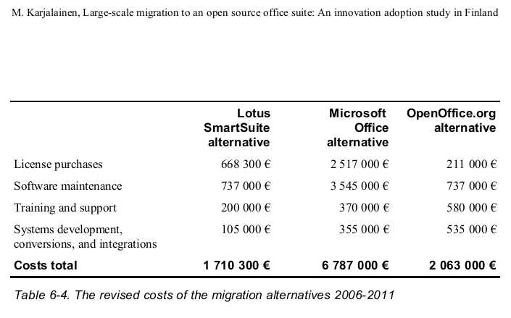
Notes:
Before execution they calculated that the total cost of ownership for OpenOffice would be 2 million euros in the years 2006-2010, while using Microsoft Office would cost 6,8 million euros in the same timeframe.
Later in 2010 they did another calculation looking back at what the total cost of ownership for OpenOffice really had been.

Slide 15
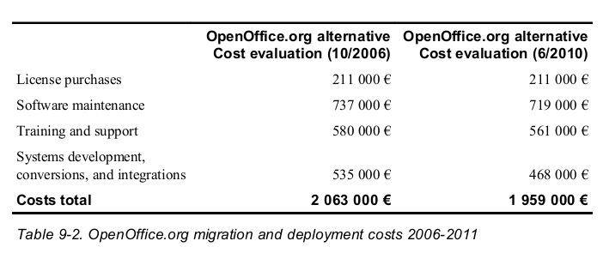
“The first 4 years have not brought any special cost surprises in the migration [..]”
Karjalainen 2010, page 187
Notes:
If fact, OpenOffice had been slightly less expensive than estimated. When you think of government IT projects, you know that actual costs are almost always much bigger that what was originally expected. Thus it is amazing to see that here they did actually go under budget. The total cost of ownership was only 1,9 million euros, compared to the estimated 6,8 million for Microsoft Office. That means that they saved 5 million euros. This means 70% savings from what they would have spent otherwise. It also means that 5 million euros less where sent to Microsoft's tax havens and all of this 2 million euros spent on OpenOffice stayed and multiplied inside the Finnish economy.
If others where to follow this example, public agencies in Europe could save 70 % on their office software costs on a very quick schedule, and without any drawbacks. The ministry did not give up on anything, they just switched to another software that is equally good or in some ways even superior. For example LibreOffice natively uses an ISO-standardized file format that is guaranteed to still be accessible in 20 or 50 years time, which is a significant feature not available in current Microsoft Office.
Yes, Microsoft has tried to give the impression that they would also offer that feature, but no version released to date follows the Microsoft OOXML standard, and anyways the standard allows embedded binaries and other creepy features, so even if they where to follow the standard they've written, it allows them to do documents that cannot be fully opened using the information written in the standard.
And you know what, the 70 % in savings is an underestimate.

Slide 16
“However, it can be noted that during the years 2006-2009 the number of workstation computers had increased from 10 500 to 11 600 in the organization. Due to the benefits of open source licensing, the increase of workstations did not involve increases in the office suite licensing costs.”
Karjalainen 2010, page 187-188
Notes:
It turns out that the cost estimate of the Microsoft option was too low, since the 6,8 million euros would not have covered the costs of the new workstations they needed. So 70% savings was an underestimate and this example shows that when the migration was finally done, there where no significant drawbacks and certainly no drawbacks that would outweigh all the benefits.
And this figure contains the costs of the migration. Now when the migration is done, the ongoing costs of using LibreOffice are likely to be even lower.
As a side note, keep in mind that the cost for LibreOffice is still not zero, only the license cost is zero. You still need invest in a support contract or pay you own staff to operate the office suite on an enterprise level.

Slide 17
?
Notes:
Ok, so now the big question is, why isn't LibreOffice more common in Europe? If this is so great, why isn't everybody using it?

Slide 18
Technical issues?
Notes:
Is there some technical feature missing from LibreOffice? No, I don't think so. And even if there was a feature missing that is blocking the migration in a specific organization, even if the organization is small like the Finnish Ministry of Justice, they could invest some of their current budget to develop the missing feature, and still save millions of euros.

Slide 19
Lack of support services?
Notes:
Is there a lack of other support services? No, there are many of companies of all sizes that offer support services and basically anything that needed to successfully deploy and maintain LibreOffice in a way that optimizes the benefits of the using organization is available from professional IT companies.

Slide 20
Lack of political support?
Notes:
Is there maybe some political agenda that steers our governors away from using LibreOffice? I don't think any politician in Europe has the opinion that shipping loads and loads of license fees to Microsoft's tax havens is a good policy. I don't think any politician in Europe objects paying support service fees to local businesses. Neither do I think that there are any politicians who would view the ability to do local customization, translations or other independent adaptations as negative things.

Slide 21
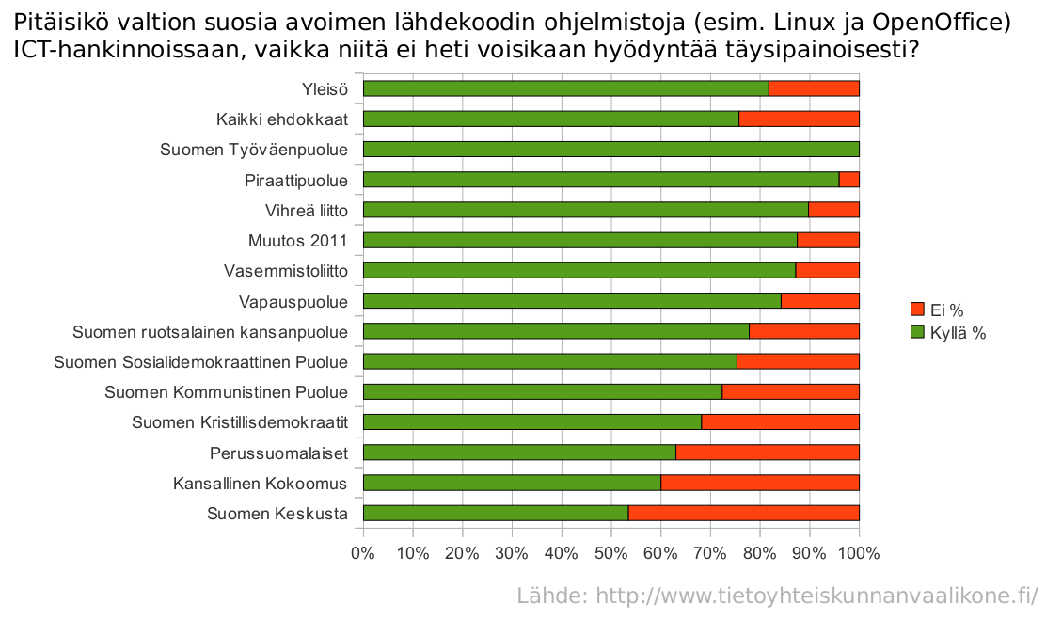
Should the government prefer open source software in IT procurement? General public >80%, candidates >70% and even the least pro-open party >50% says YES
Notes:
This poll was made in 2011 to parliament candidates and it shows that the majority of candidates in all political parties in Finland are in favor of increasing the usage of Linux and other opens source software in Finland.
The problem lies somewhere else. I do not claim that I know everything, but I have some experience with the issue and I'll try to outline what I've found out while trying to advocate the cities of Helsinki and Tampere to start using LibreOffice. I will also try to suggest some possible solutions.

Slide 22

Notes:
Yes, at the core of the problem is Microsoft. If you look at software like LibreOffice, Firefox and Linux, they all threat Microsoft's core business and Microsoft has a strong incentive to do everything they can to stop them from becoming common.
I am not trying to be politically correct, when we speak about LibreOffice and it's competitors, there is really only one enemy, and that is Microsoft, so I'am going to refer to Microsoft directly by name.
I think the best way to resist a huge international company is to join forces and make our own huge international organization. To support LibreOffice you can for example donate to The Document Foundation or get active by and do some contribution, although I assume everybody here already does that.

Slide 23
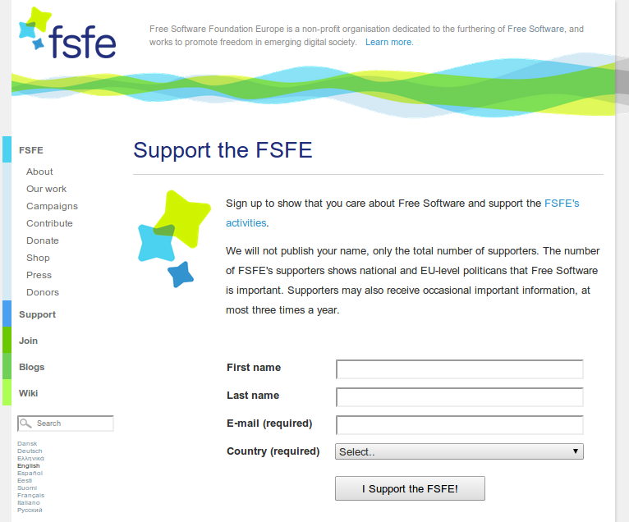
fsfe.org/support/
Notes:
To promote Free Software in general I recommend you also sign up as supporters of the FSFE. It's like signing a petition and it does not cost a thing. You can easily be both in the Document Foundation and the FSFE, they are not in any way exclusive options.
A few slides ago I asked you why isn't everybody using LibreOffice if it is so great. There certainly is already a lot of LibreOffice users, it is just not nearly everybody yet.

Slide 24
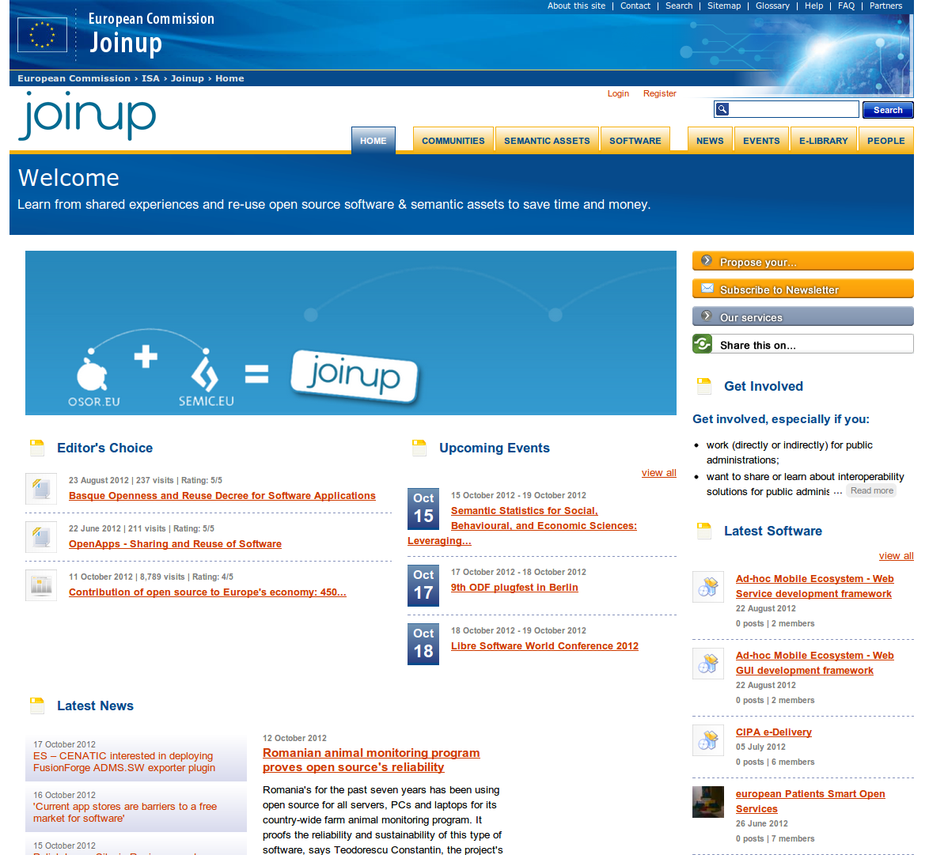
Notes:
The European Comission has a website called JoinUp, which some of you might remember by it's former name OSOR.EU. There is a large collection of case studies and news related to Open Source Software usage in the public sector in Europe. I know many Finnish cases are missing from there, so the directory of cases is certainly not complete, but there are a lot of good successful cases presented there.

Slide 25
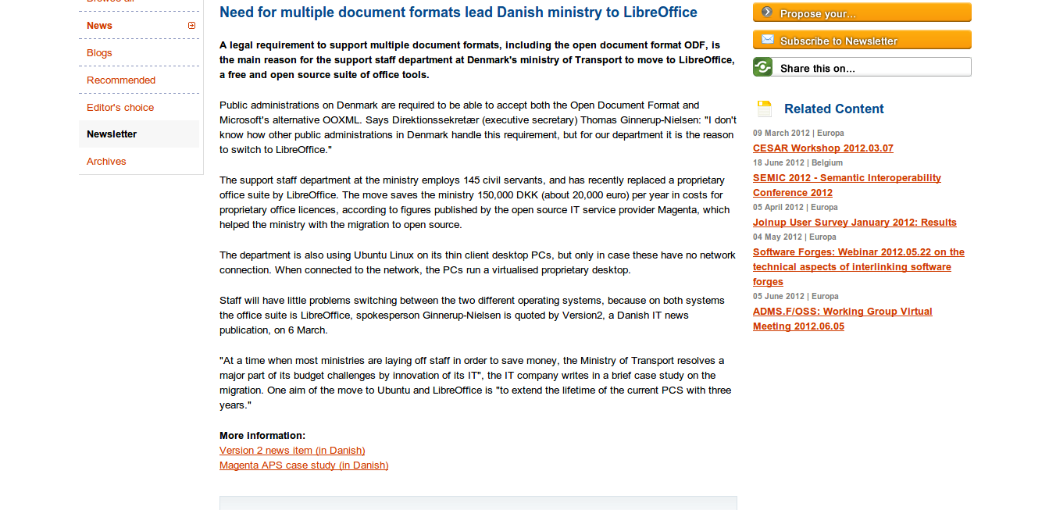

Slide 26
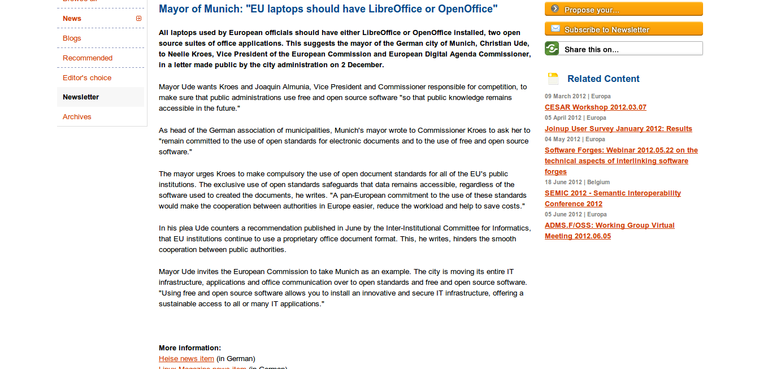

Slide 27
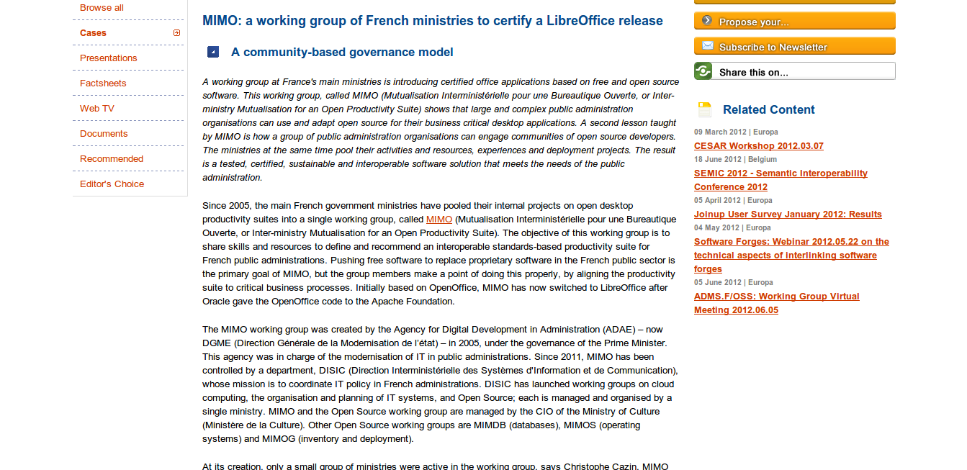

Slide 28
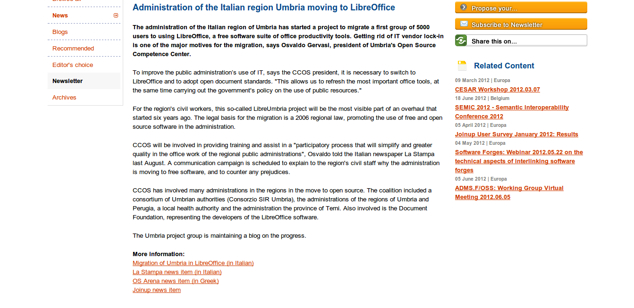

Slide 29
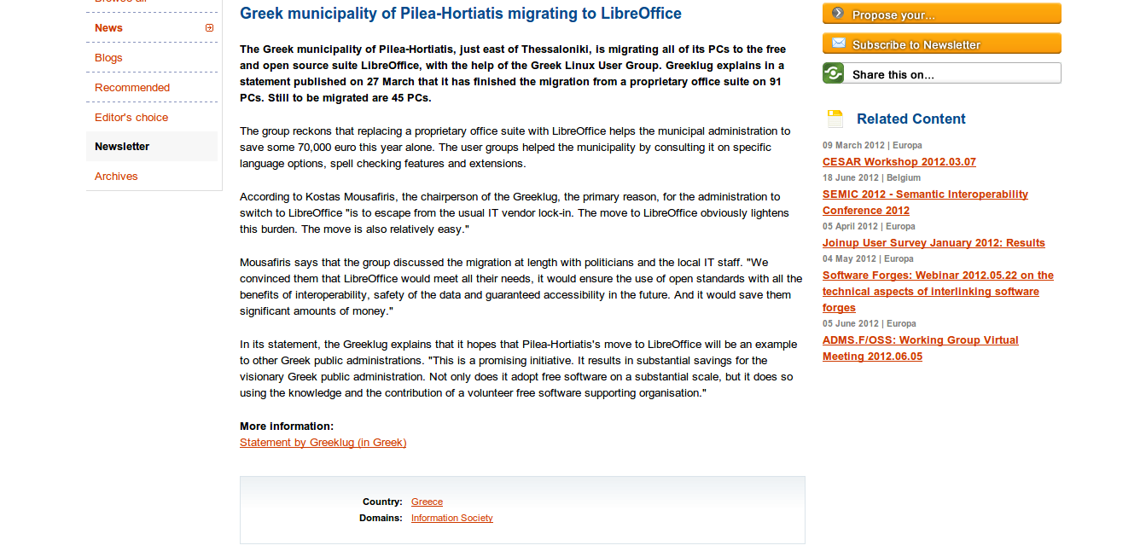

Slide 30
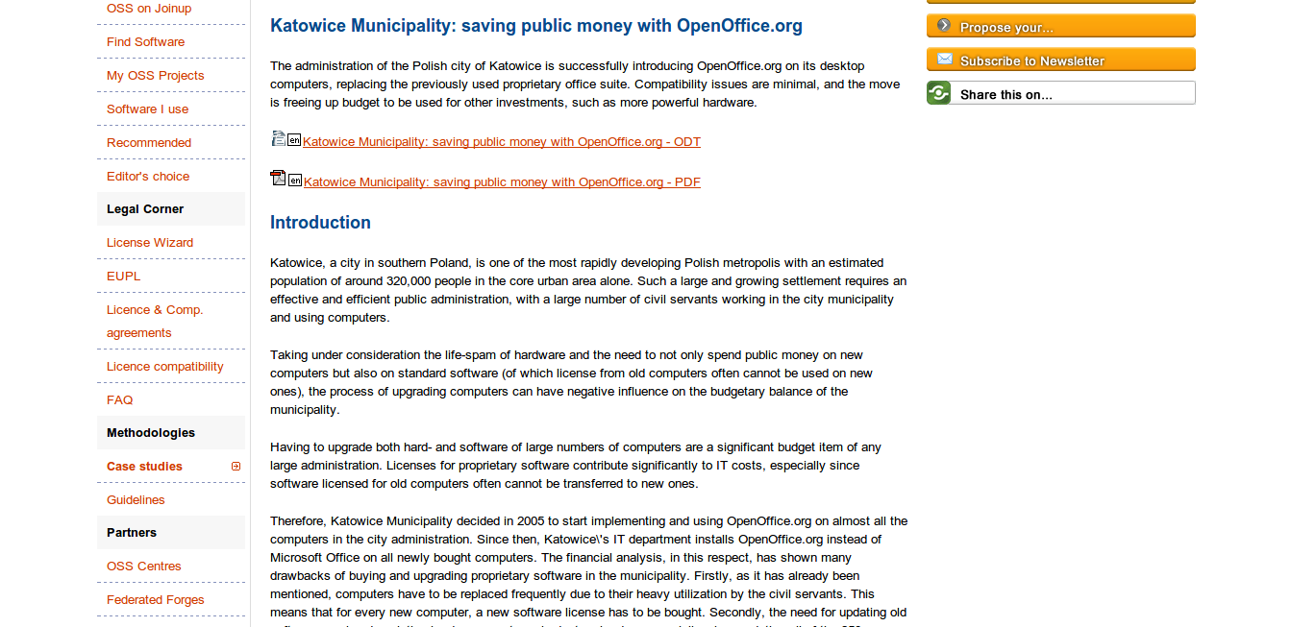

Slide 31
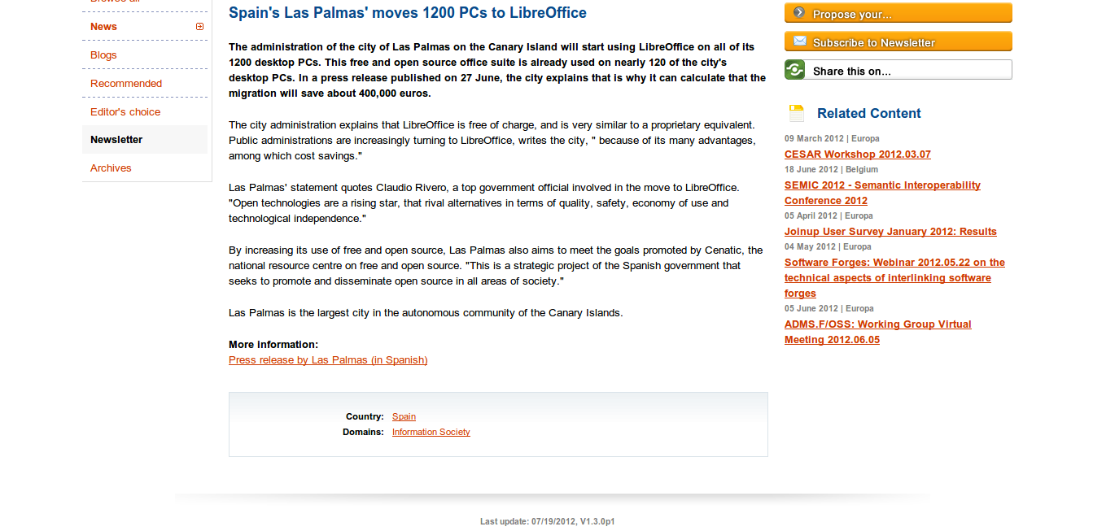

Slide 32
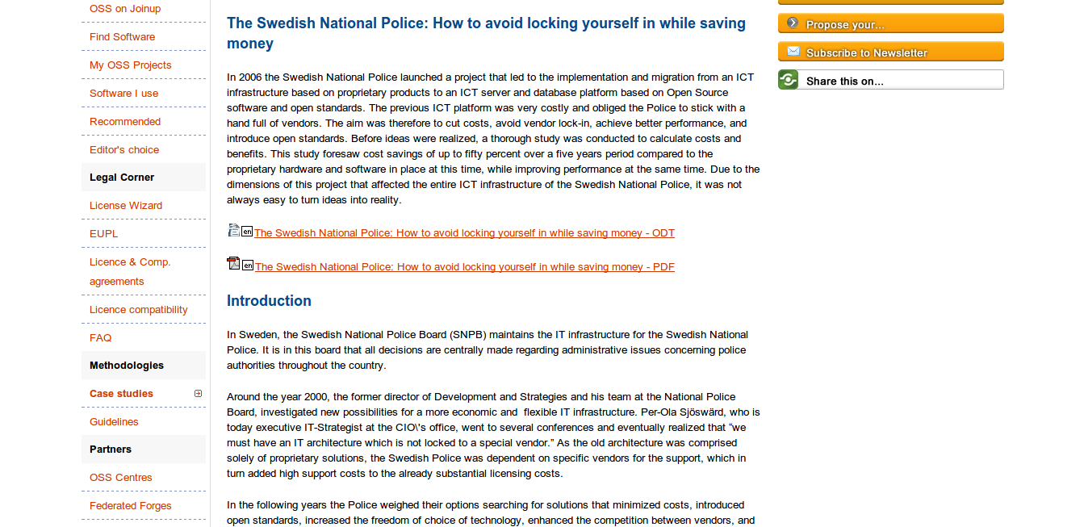
Notes:
One of the challenges we have is that these cases are not as well known as they should be. When I talked to people in Helsinki and Tampere I noticed that they hadn't heard of almost any of these cases in Europe. Some had heard of the City of München case, and they where under the impression that the Linux migration there had failed.
Microsoft seems to excel at public relations and their marketing muscle has the power to make any LibreOffice failure well known, while masses of LibreOffice successes go unnoticed by the media. Microsoft can even make successes look like failures, as they tried to do in the City of München case -- which, for the record, is going fine and they have been expanding their roll-out of Linux workstations and those of course also include LibreOffice.

Slide 33
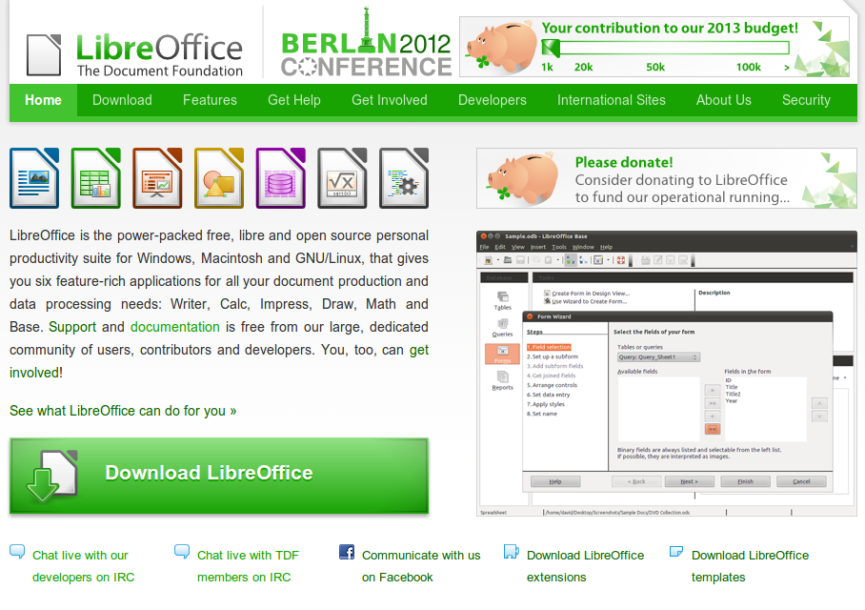
Notes:
It is a pity that if somebody visits the current LibreOffice website, there is no case presentations or success stories available. I've also checked the websites of some of the support service provider companies and they are not doing a much better job either.
Microsoft again has done a much better job at listing these cases..

Slide 34
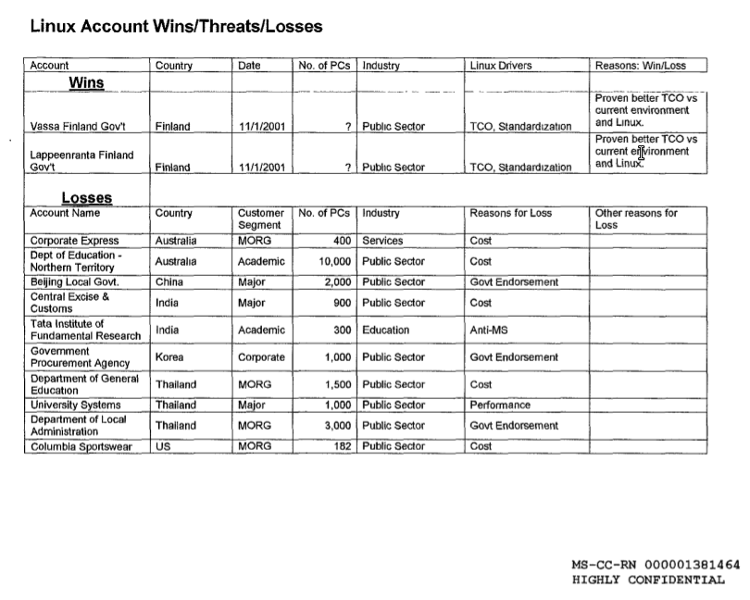
www.groklaw.net/pdf/Comes-9685.pdf
Notes:
..and this example became public as it was used as an evidence at a monopoly trial in the USA.
For some strange reason the only two successes from Microsoft's side was two cases in Finland, the city of Vaasa and the city of Lappeenranta. In both cases Microsoft marked as the success factor the use of the Total Cost of Ownership argument, abbreviated TOC. Neither of these cities actually did any migration, as their plans where stopped in the planning stage.

Slide 35
Total Cost of Ownership – TCO
Notes:
Let's think a bit about the TCO argument. It forms the cornerstone of Microsoft's argumentation and we need to help people see trough it.

Slide 36
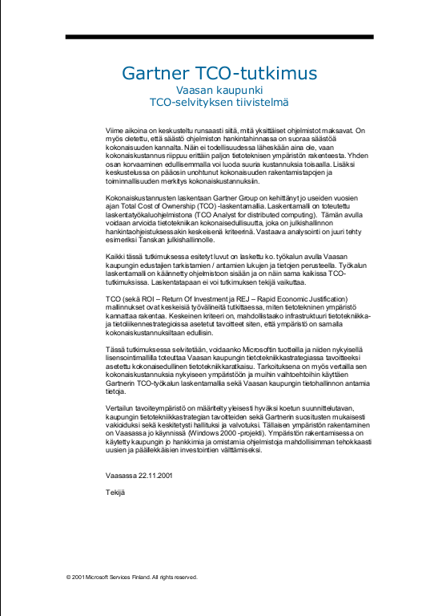
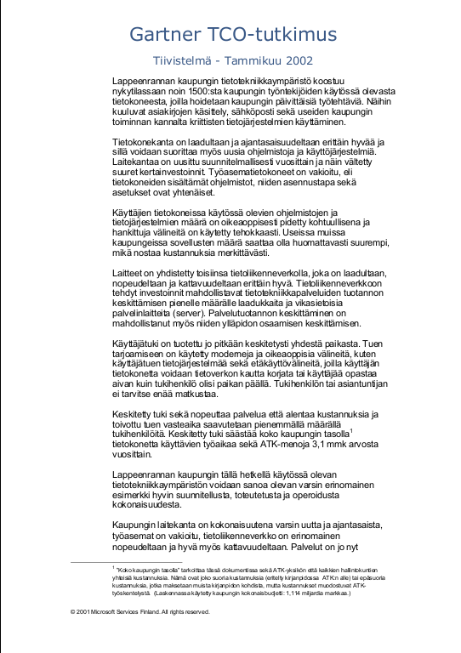
Notes:
Even though the cases of Vaasa and Lappeenranta are almost 10 years old, Microsoft Finland still has these case studies on their website.
These are highly questionable calculations claiming that TCO for Microsoft products is less than any with any open source option. In fact in Lappeenranta, some years later, they did switch to Linux desktops, but in schools only, and based on the school administrations own calculations the TCO for Linux desktops was 70% less expensive. This seems to happen all the time. TCO estimates done by pro-Microsoft analysts predict huge costs, but cost analysis made afterwards by public institutions themselves looking back on actual costs, show that there are 40-70% of savings in total cost of ownership.

Slide 37
Helsinki migration to LibreOffice:
21,5 million euros
Notes:
At the end of 2011 the City of Helsinki also made a TCO calculation that showed that the migration to LibreOffice would cost over 21 million euros, spanning a seven year migration period, and using report referencing this calculation the IT department tricked the city board to make the conclusion that LibreOffice is not worth investigating further. Later the IT department of the City of Tampere referred to that same calculation as a motivation to why they don't need to take LibreOffice seriously either and the Tampere City Board swallowed it.
In all of these cases the actual TCO calculation of is secret, so nobody really knows why these calculations ended up with the figures they did. The cities (or the consultants working for the cities) used a proprietary calculation model from the so called research institute Gartner. Gartner considers the calculation model their trade secret and forbids any publication of it. In the case of Helsinki, not even the City Board members have yet had access to the calculation.
So in the end what has happened in Finland is that we've had city council initiatives demanding LibreOffice usage in many of the biggest cities, including Helsinki, Tampere and Turku. All of this initiatives passed the council with clear majority but it seems that the officials working in the IT departments want to continue to celebrate their relationship with Microsoft and the execution of these initiatives have halted, using the TCO as the excuse.

Slide 38
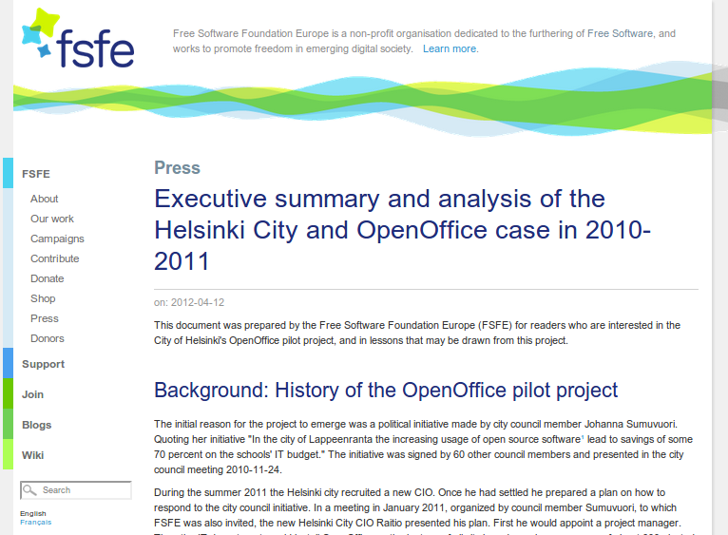
fsfe.org/news/2012/news-20120412-02
Notes:
There is an analysis of the Helsinki case at the FSFE.org if you want to read all the details.

Slide 39
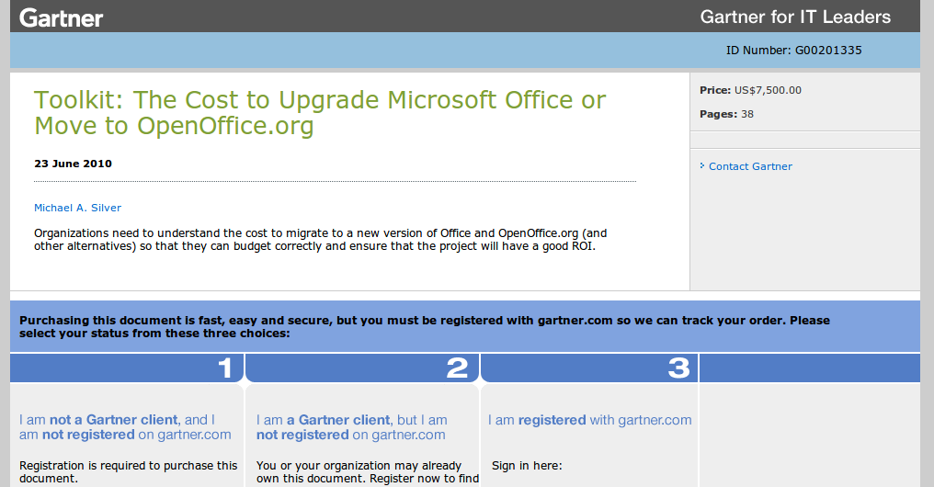

www.gartner.com/id=1389621
Notes:
We don't have any of the details of the TCO claims, since the Gartner report is secret.
In theory we could get a copy..
[zoom]
..but we would need to pay 7500 US dollars, and that is a barrier we can't justify ourselves to overcome.
I really wonder how Gartner has any credibility left as a research institute if their research is secret, and there is no possibility to do any kind of scientific validation. Also, the latest calculation model used by the City of Helsinki is written by one man alone, Michael Silver.
[zoom]
How come is he supposed to alone be an expert on these issue? What sources did he use? To what extend are any of his conclusions valid?

Slide 40
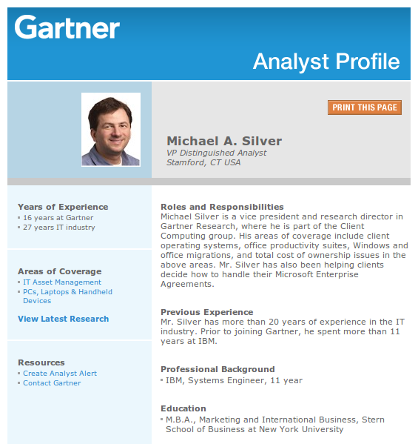
Notes:
This is his profile at Gartner..

Slide 41
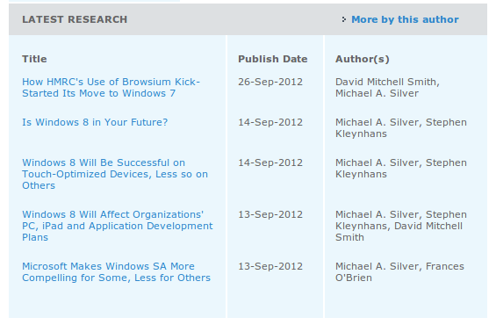
Notes:
...and he certainly is an expert on Microsoft issues, but what about Free and Open Source Software?

Slide 42
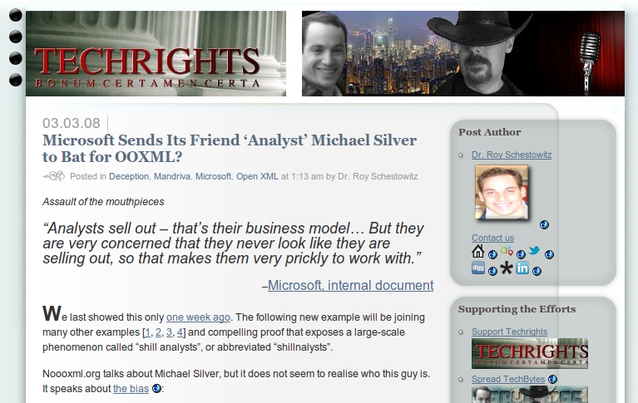
techrights.org/2008/03/03/michael-silver-ooxml-shill/
Notes:
I Googled this name and it turns out he has been accused of favoring the Microsoft OOXML standard over the Open Document Standard used by LibreOffice, IBM and almost all other office suite vendors today.

Slide 43
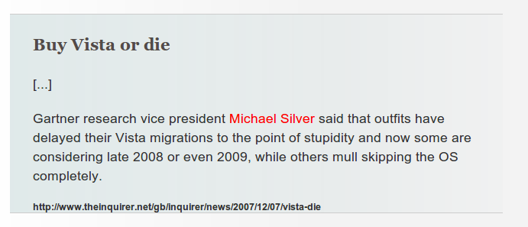
Notes:
He is also quoted to have said that all who skip Vista and upgrade XP to the Windoes version after Vista are idiots. It seems this Mr. Silver surely had a bias towards making any alternative to Microsoft Office look bad.
This surely enough evidence to seriously question the validity of this type of unscientific analyst sources.
Just think about it. How on earth can Gartner's calculation show that the migration to LibreOffice would cost the City of Helsinki 21 million euros? And the report from the City of Helsinki even states that they where conservative using the Gartner model, not including all possible costs. Among others we know that this figure did not include any estimates on what support contracts for LibreOffice could cost, thus the 21 million consists purely of exit costs caused by escaping the Microsoft Office lock-in. And yet it is 21 million euros?
This is a huge gap to any figures presented in the European case studies at Joinup or compared to the Ministry of Justice in Finland. Surely there are some Helsinki specific differences, but they can't amount up to a tenfold cost compared with the Ministry of Justice in Finland.
If we think about the success factors at the Ministry of Justice, one very central piece was this.

Slide 44
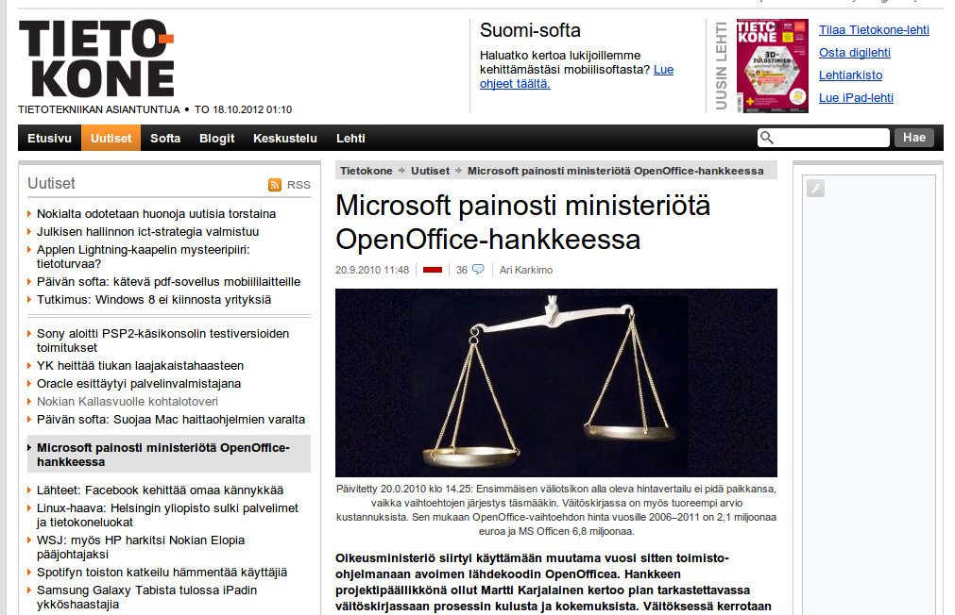
The CEO of Microsoft Finland approached the highest officials in the Ministry of Justice. First Microsoft offered to cover for the Microsoft Office training costs, but when that didn't catch on, they delivered a 28 page report that questioned the calculations and conclusions done by the ministry's own IT staff.
But the highest officials backed their IT staff and did not give in for Microsoft's demands. Later Microsoft also offered to pay the cost for an “independent” TCO study, but the ministry declined.
Notes:
The Ministry of Justice didn't accept Microsoft's offer to sponsor them a so called "independent" study and calculation of costs.
If you want to do an successful LibreOffice migration and save you agency millions of euros, you must have the support of the highest ranking officials in the organization Otherwise Microsoft will just take them golfing or whatever and show them figures that sound credible, but that are nothing more than a carefully crafted deception designed for just one purpose.

Slide 45
Did Microsoft lie?
Notes:
No, Microsoft just selects the part of the story they want to tell and leave to others the job of filling the gaps. Microsoft spokesmen are trained to never lie. They leave that job to their partner companies to do.

Slide 46
“Selective truth”
Notes:
But you can't call Microsoft's version of the story true either. They are trained to tell what is called 'selective truth'.

Slide 47
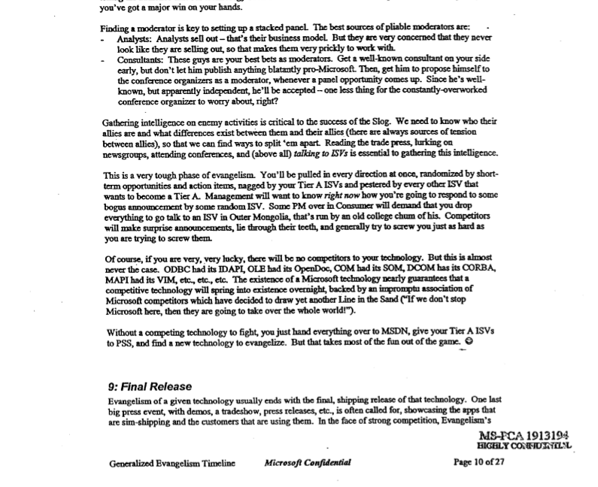
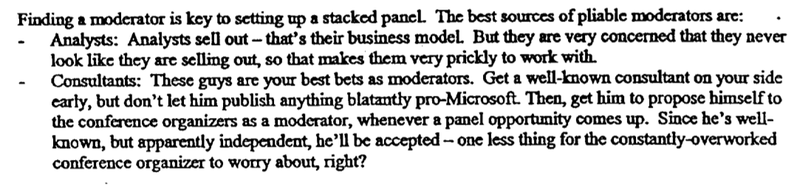
antitrust.slated.org/www.iowaconsumercase.org/011607/3000/PX03096.pdf
Notes:
This is another document from the Comes vs. Microsoft monopoly trial. It is from an internal marketing training material and shows what kind of tricks they recommend at Microsoft.
[zoom]
Let's have a look at the same Microsoft document I presented you earlier.

Slide 48

Notes:
This document includes a description of Microsoft's Education and Government Incentives Program, abbreviated EDGI. It is a special fund inside Microsoft that local Microsoft branch managers can draw funds from to fight Linux. The slogan goes "Never loose".

Slide 49
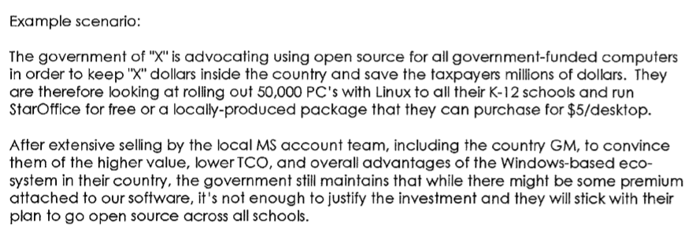
Notes:
Here is a little about the mindset they have.

Slide 50
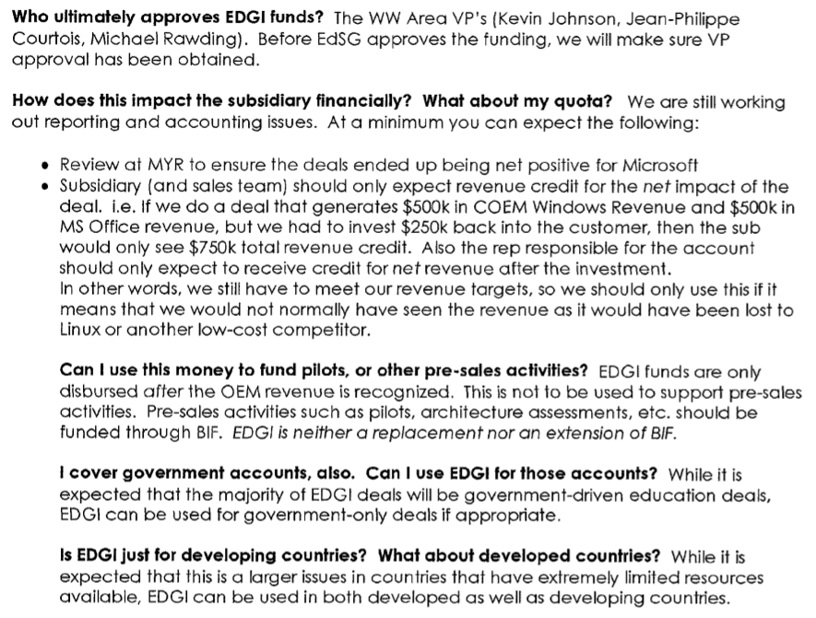
Notes:
This is just an example showing how well managed Microsoft is.

Slide 51
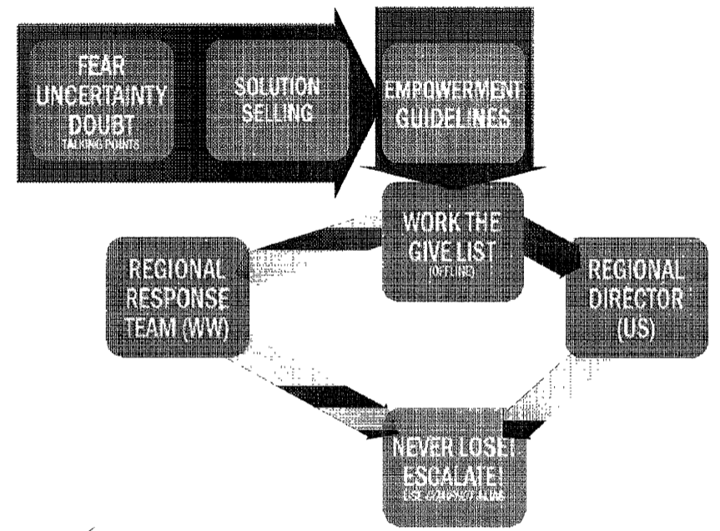
FUD!
NEVER LOOSE!
Notes:
The same document also recommends using the Fear, Uncertainty and Doubt tactics at Microsoft, to stop customers from switching to Linux or LibreOffice (at that time called StarOffice).

Slide 52
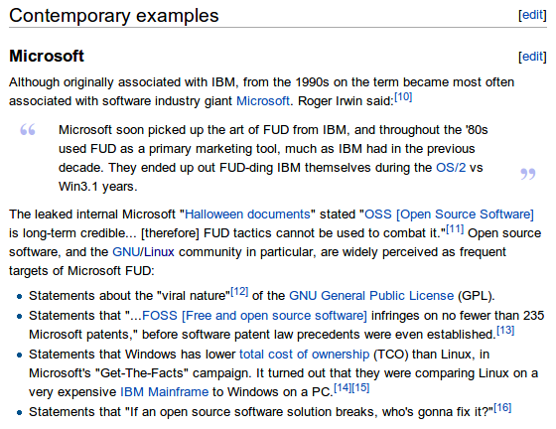
wikipedia.org/wiki/Fear,_uncertainty_and_doubt
Notes:
Fear, Uncertainty and Doubt is abbreviated FUD and if you look up the definition in a dictionary, you will find Microsoft.
The FUD tactics has been used by Microsoft for a long time, but it is still seems to work and we need to tackle it better.

Slide 53
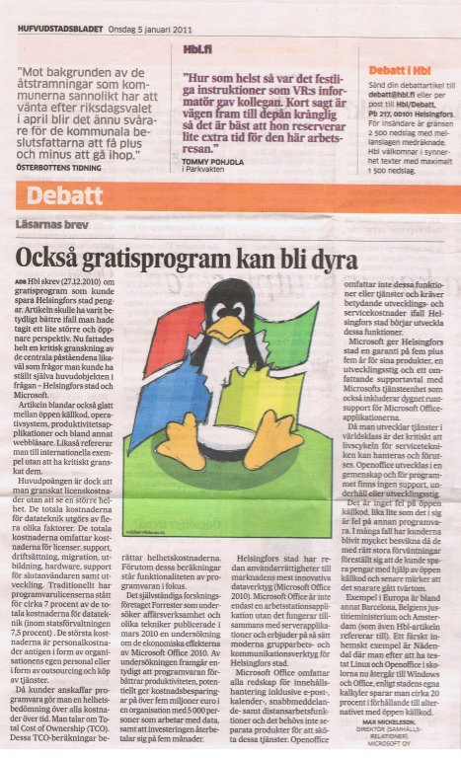

“licence cost only 7,5 %”
“labour biggest source of costs, and since MS has the most productive toolsa according to Forrester research, MS has lowest TCO”
“MS provides 24/7 support while nobody provides support for OpenOffice”
“Barcelona, DoJ Belgium and Amsterdam failures”
Notes:
One of the main arguments that I've seen used by Microsoft spokesmen over and over again is, is that even though the licence fee makes Microsoft the more expensive option, the licence fee is only a small part of the total IT budget and it does not really matter. What these spokespersons leave untold, is that the license of the platform creates a major lock-in situation, that actually controls all other costs too.

Slide 54
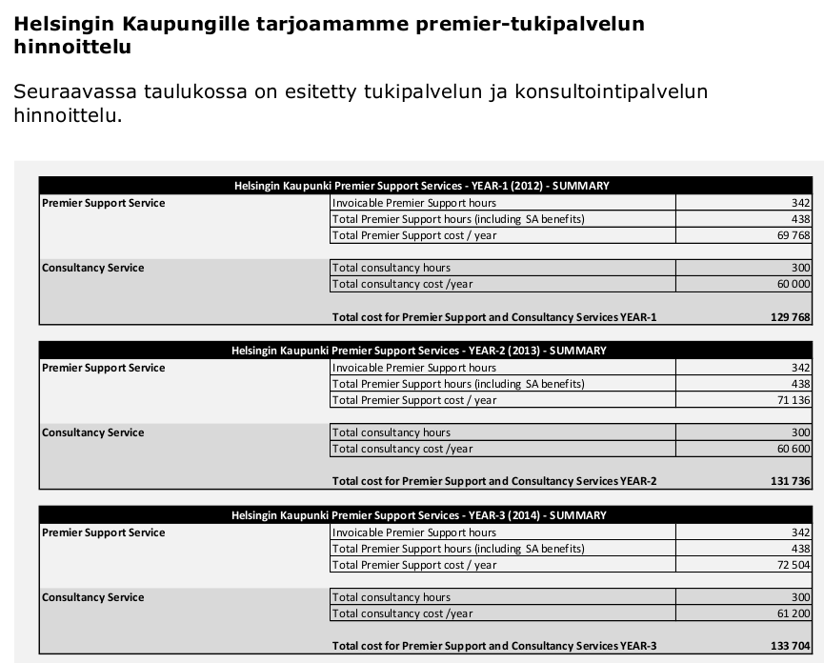
City of Helsinki
Microsoft Premier Support:
1926 man hours
395 000 €
205 €/h
Notes:
For example City of Helsinki was forced to buy 1900 hours of support services from Microsoft to the price of 205 €/hour. These would never happen in a competed market
Also Microsoft spokespersons claim that organisations using Microsoft products are much more productive that those using other products, thus the added productivity saves more man-hours of work than what the Microsoft premium costs. And the claim that Microsoft users have the best productivity is based on research done by an independent research institute. Does anybody want to make a guess what the name of that institute is?

Slide 55
TFC
Notes:
Now it is time to welcome TFC

Slide 56
FUD → TFC
fear → trust
uncertainty → facts
doubt → confidence

Slide 57
Trust – make them experience LibreOffice
Notes:
There are still surprisingly many who have not tried LibreOffice themselves, or who might not even heard much about LibreOffice before. Give LibreOffice to individuals and help them try it on their own computers. Install LibreOffice as the secondary office suite in organizations to allow the personnel to try it out.

Slide 58
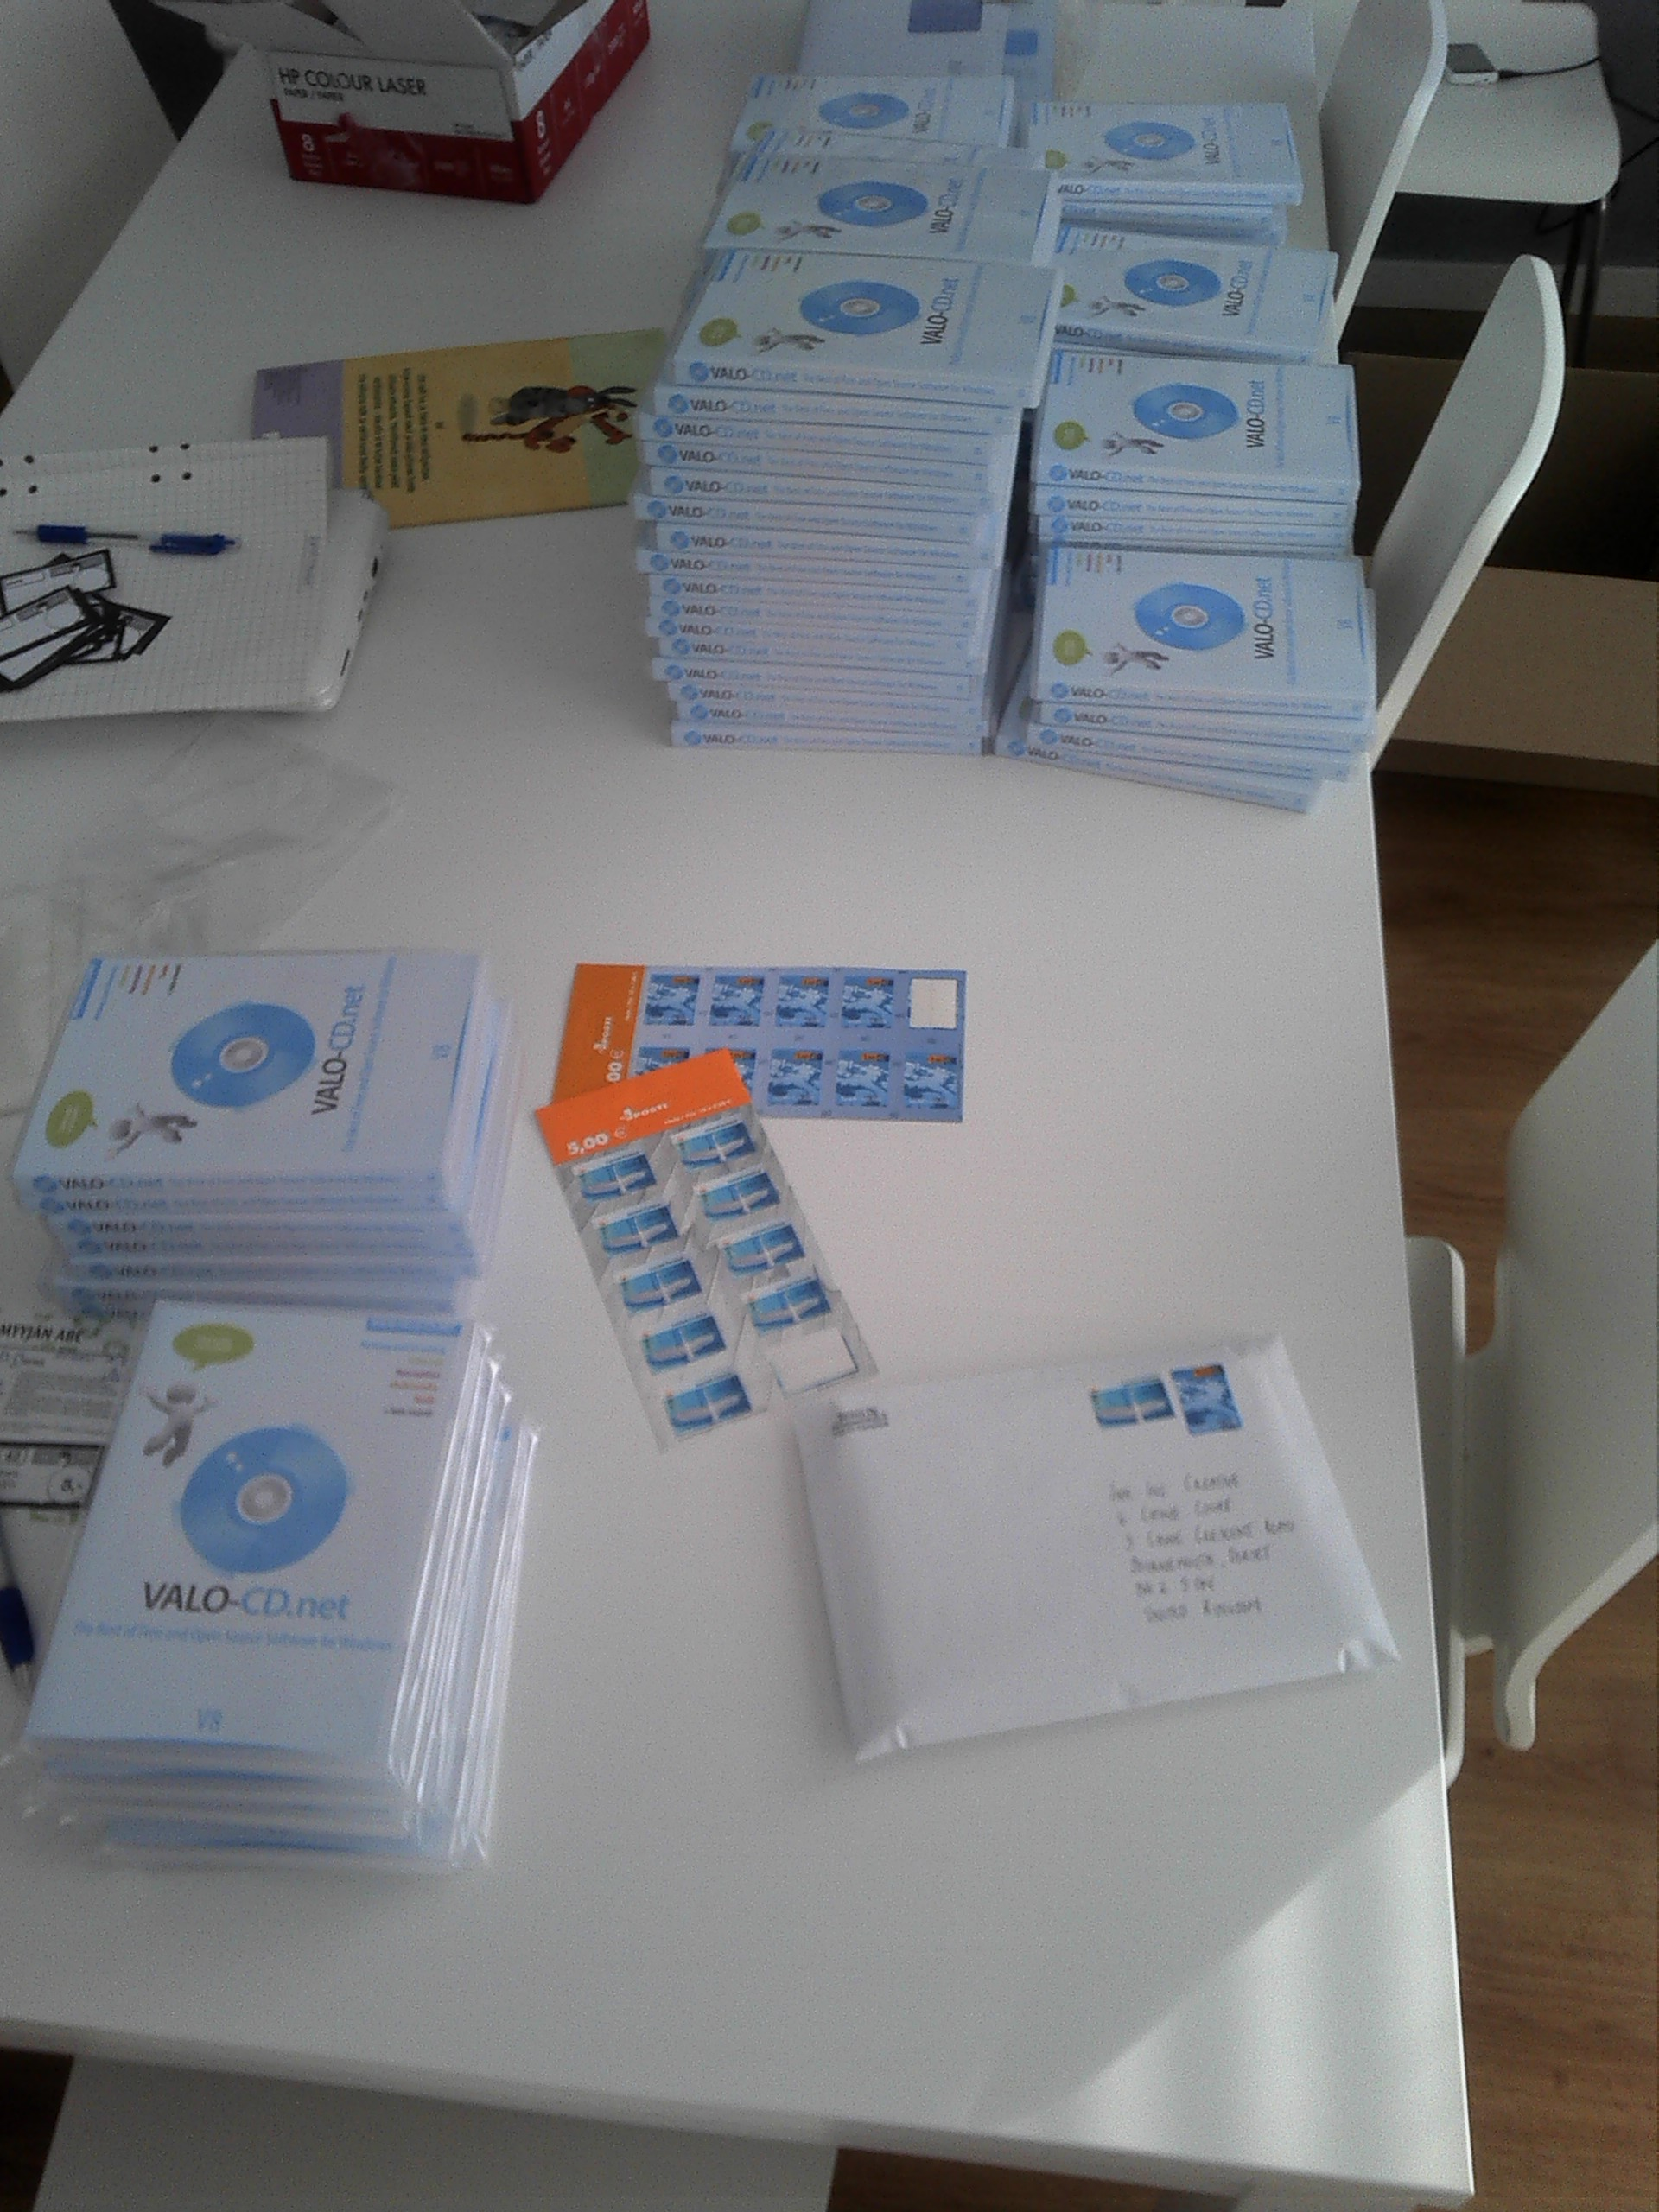

Notes:
Personally I've been doing this VALO-CD-project in Finland, witch I use to distribute among others LibreOffice to people who distrust downloading stuff of the Internet and think that proper software comes in a box. I will give out a few hundred of the English version here, and you can come and pick some if you want after the talk.

Slide 59
Trust needs time
Notes:
Another thing about trust is that also needs time to develop. The fear of the unknown will go away once people have first hand experience of LibreOffice. But only if people experience LibreOffice for a several years, even if it is only their secondary office suite, then also their fear for the community behind LibreOffice will diminish.
Sometimes it also happens that Microsoft makes a mistake and turns fear against themselves. For example in Helsinki, after the city council initiative to investigate LibreOffice had been made, a senior Microsoft executive contacted the author of the initiative, Johanna Suomuovuori, who was not only a Helsinki city council member but also at that time a Member of Parliament in Finland. The Microsoft spokesperson requested to get an audienceas soon as possible. Sumuvuori was baffeld about their attitude but did manage to make room in her schedule to have a meeting. When the Microsoft spokesperson came to the parliament he had three pages of paper with him. It was a version of the city council initiative, with every paragraph annotated with a pro-Microsoft arguments trying to prove the whole initiative false. This only reinforced Sumuvuori's hunch that she was onto something big and she started pushing the execution of the initiative harder.

Slide 60
Facts: case studies academic publications scientific cost model
Notes:
This should be relatively easy. The Document Foundation needs to publish case studies, academic research and a scientific cost model. The former two already exist, they just need to be summarized at the LibreOffice website or some other prominent place. There are also some cost models, but they need to be fine tuned and made into an online calculator that is easy to use and that of course has the source code and calculation model publicly available.

Slide 61
Confidence – Made a personal connection
Notes:
This is the hardest part. I think the only way to gain confidence is to make a personal connection. You have to put yourself as a person on the line and allow for confidence to grow. Those who learn to know you and respect you, are also likely to have confidence in your recommendations and opinions. And to make a good personal connection you need to meet people in real life, talk with them, meet them over lunch or for example organize some joint event or something.
Even though many technical developers might not love the idea, we do need sales people. Sales people know how to build confidence. Unfortunately I don't know in Finland a single case of some kind of LibreOffice salesman meeting a public sector representative and telling what kind of services the support vendors in Finland could provide.

Slide 62
Trust
Facts
Confidence
TFC
Notes:
Hands up, how many of you think that this makes sense?

Slide 63
Vote!
Notes:
We also have a tool that Microsoft does not have. We have democracy. We can vote and influence how our tax money is spent. Next time there are elections in your country, remember to check the stance on this issue from your candidates. FSFE works with collecting this data, you might want to check the "Ask you candidates" -campaign at the FSFE.org website.

Slide 64
Critical mass
Notes:
When I read these internal Microsoft documents that have become public via the monopoly trials. I can clearly see that they are very afraid of Linux and LibreOffice gaining so called critical mass. Nobody knows how big the mass needs to be to become the tipping point, but it certainly does not have to be a 50% market share. If we look at Firefox that in Europe reconquered the market back from Microsoft Internet Explorer and made the web an innovative place again, I'd say the tipping point was somewhere around 10%. Apple computers has certainly gone very fashionable and still if you count it's popularity in terms of market share of desktop computers and laptops, it is just around 10%.
StarOffice, OpenOffice and finally LibreOffice has gone a long way to reach where it is today. Some certainly hope that it would have gone further by now. But history does not dictate the future. The speed if bound to become faster from now on, and I believe the download figures at LibreOffice.org proves that.
I believe we are close to critical mass, we just need to push a little bit more and we will see the gates flood.
Let's work so that by the time of the next LibreOffice conference, in choosing LibreOffice does not constitute a risk to the decision maker's career, but is the expected thing to do all around Europe and *not* migrating to LibreOffice will need to be justified.
Thank you!

Slide 65

Support the FSFE!
fsfe.org/support
Visit fsfe.org/support with you device now!
Notes:
FSFE also has a lot of important work going on related to software patents, open standards, public procurement and other stuff which I just could not fit into this presentation, so please read more at FSFE.org. And while you are at it, please also sign up as supporters, thanks!
This presentation will also be available at FSFE.org later today.

